Slide 1
WageWise
Employment Payment Management System
COMP3773 – Advanced Object-Oriented Programming
Melita Leonie Pereira - 0307264p

Slide 2
Objectives
Build a functional payroll management system in C++
Apply advanced OOP concepts (encapsulation, inheritance, polymorphism)
Integrate multiple design patterns in a meaningful way
Implement persistent storage using CSV file handling
Provide payroll admins with tools for managing employee records
Support hourly vs salaried employees with dynamic pay calculation
Generate payslips with adjustments (bonus/penalty)

Slide 3
Overview
Console-based payroll management application
Supports two employee types: Hourly and Salaried
Automatically calculates pay based on employee category
Stores and loads data from CSV using an adapter class
Centralized employee management through Singleton pattern
Clean separation of responsibilities across classes

Slide 4
Core Functionalities
Employee Management
Add new employees
View all existing employees
Search by employee ID
Update name, position, department, or pay
Delete employee
Payment Processing
Calculate hourly pay or salaried pay
Apply bonus or penalty
Generate formatted payslips
Data Persistence
Load and save employees via CSV
Uses an adapter to map CSV to Employee objects

Slide 5
OOP Features
Encapsulation
Private member data
Getter/setter methods
Inheritance
HourlyEmployee
SalariedEmployee
Polymorphism
Virtual methods
displayInfo
calculatePay
getEmployeeType
Base-class pointers managing derived objects
Abstract Classes
Employee is fully abstract
Operator Overloading
Operator<< for printing Employee details
PaymentSlip += and -= for adjustments

Slide 6
Design Patterns
Factory Method
EmployeeFactory creates Hourly or Salaried employees
Removes new from main and centralizes object creation
Singleton Pattern
EmployeeManager ensures single global instance
Central point for storing, searching and managing employees
Strategy Pattern
Each employee type has its own pay-calculation strategy
calculatePay() polymorphically executes type-specific logic
Adapter Pattern
CsvDataSource adapts CSV files to Employee objects
Outputs Employee* objects using Factory

Slide 7
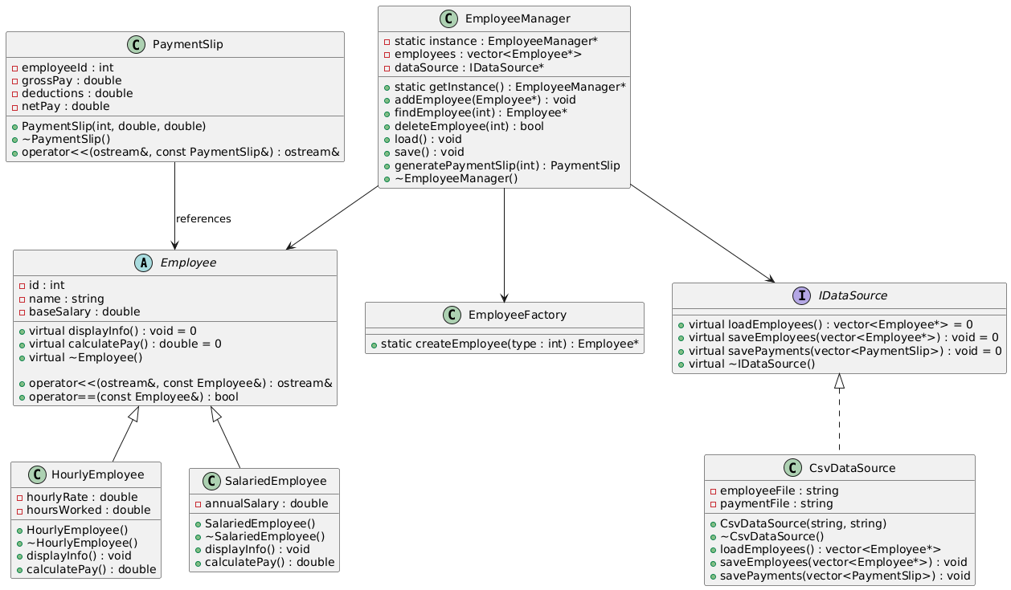
UML diagram

Slide 8
Architecture
Employee (abstract)
HourlyEmployee
SalariedEmployee
EmployeeFactory
Creates hourly or salaried employees
EmployeeManager (singleton)
Manages Employee*
Handles CRUD
CsvDataSource (adapter)
LoadEmployees()
SaveEmployees()
PaymentSlip
Uses operator overloading for adjustments

Slide 9
Future Scope
Add validation for incorrect inputs
Implement sorting and filtering
More employee types (contract, commission-based)
GUI instead of basic console or command-line interface
Encrypt sensitive employee data
Introduce unit testing
Improve CSV import/export (error detection)

Slide 10
Reflection and Conclusion
This project improved understanding of real-world OOP design
Learned how to apply multiple design patterns together
Gained experience with file handling and data persistence
Understood the importance of clean architecture and modularity
Future improvements can possibly make it production-grade

Slide 11
Thank You

